Slide 1
Lending Club Case Study
By – Hargurjeet Singh

Slide 2
Content
Problem Statement
Feature Identification to be considered for loan approval
Reference

Slide 3
Problem Statement
What is the business problem that your project is trying to solve?
The current exercise should help to understand the driving factors behind the loan default as loan defaults are the largest loss to lenders. How consumer attributes and loan attributes influence the tendency of default.
What is the dataset that is being used?
The dataset provides the details of the past loan applicants and whether they have ‘defaulted’ or not. The objective is to identify if the loan should be given, the reduced amount to be disbursed, or if the loan should not be provided.

Slide 4
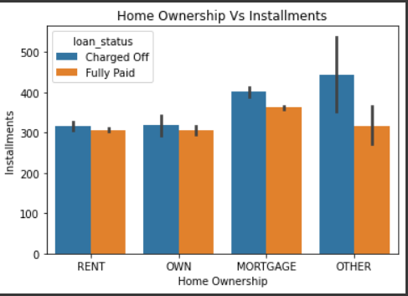
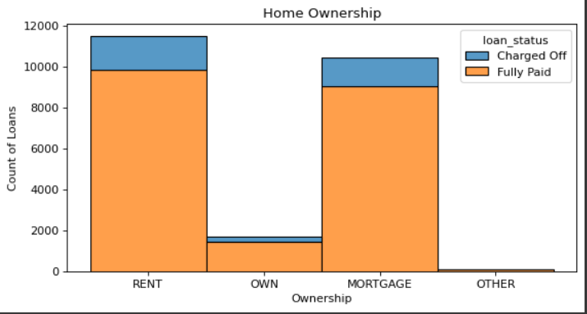
Feature Identification
Homeownership - People staying in rented and mortgaged accommodation loan defaulted more than people staying in their own accommodation. The default rate on paying the instalments are maximum when the homeownership is classified as 'Others'

Slide 5
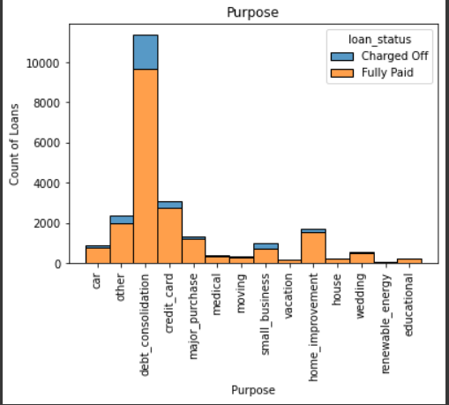
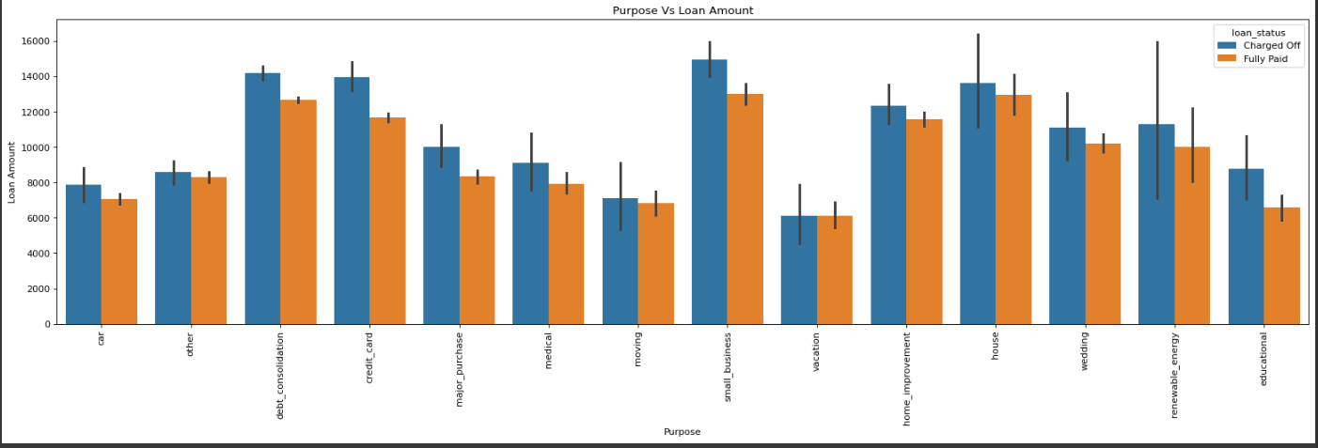
Feature Identification
Purpose - Applicants have defaulted more and are taking loans for Debt Consolidation. People taking loans for the purpose of renewable energy seems to be risky as they have defaulted on lower as well higher loan amount

Slide 6
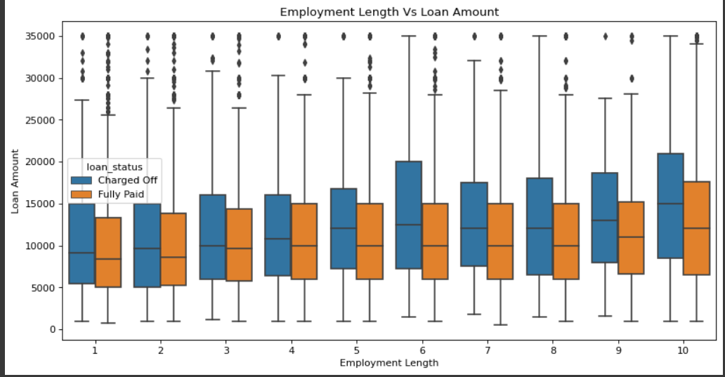
Feature Identification
Employment year - The median difference between defaulted loans and the successful loan is quite high between years 5 to 10.

Slide 7
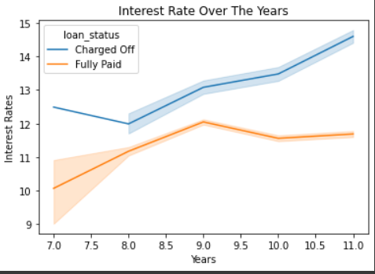
Feature Identification
Interest Rates - The interest rate are critical. With high-interest rates the chances of defaulting on the loan increase.

Slide 8
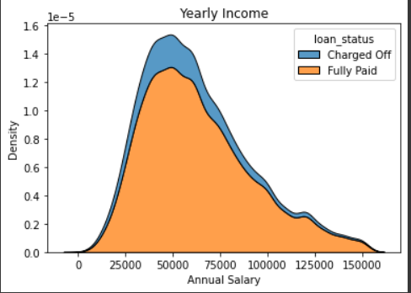
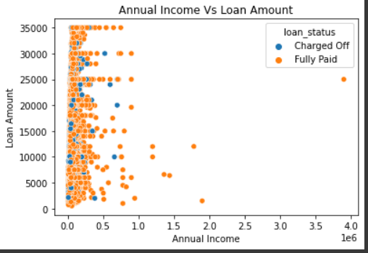
Feature Identification
Annaul Income level - Applicants with high annual income have not defaulted but applicants with low annual income have defaulted. Applicants with a median salary of around 50k seem to have defaulted the most.

Slide 9
Reference
Pandas - https://pandas.pydata.org/
Matplotlib - https://matplotlib.org/stable/index.html
Seaborn - https://seaborn.pydata.org/
Github - https://github.com/hargurjeet/Lending-Club-CaseStudy

